Slide 1














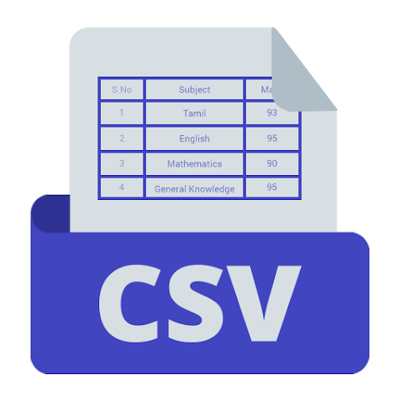




Infer dept
Canonical dept 1
√
Query
Canonical dept …
Search
Keyword Detection
Vector
DB
Cosine
Similarity
Canonical dept n
Candidate pool
Top-K Chunks
User
Retrieval
Embedding
Vector Database
Processing
Up to 3 retries (1s, 2s, 4s)
v⃗
Canonical dept 1
[Dept]
[Title]
[Ask]
[Answer]
Normalize Dept
[Dept]
[Title]
[Ask]
[Answer]
[ ]
[Dept]
[Title]
[Ask]
[Answer]
v⃗
…
…
v⃗
Ollama Embedding
Vectors
(chunk, src, dept)
Store
(embedding, source,
canonical dept)
Canonical dept n
Vector
DB
Ready!
Truncation
Cleaned Chunks
Chunks
Vectors
Vector
DB
Top-K Chunks
Top-K Chunks
Answer
Process
Top-k Chunks
User
Data Loading
Answer Generation
[Dept]
[Title]
[Ask]
[Answer]
[Dept]
[Title]
[Ask]
[Answer]
[Dept]
[Title]
[Ask]
[Answer]
Real-Life Query Collection
Evidence Block
system prompt
Ollama Processing
Chatbot response
Csv files
Cleaned Chunks

